Slide 1
Document Object Model (DOM)
Ганболдын АМАРСАНАА
Мэдээлэл, компьютерийн ухааны тэнхим
МУИС, Хэрэглээний шинжлэх ухаан инженерчлэлийн сургууль
amarsanaag@num.edu.mn
ICSI301 Вэб програмчлал
2016 оны Хавар

Slide 2
Objectives
Use JavaScript and the W3C Document Object Model to create dynamic web pages
Learn the concept of DOM nodes and DOM trees.
Traverse, edit and modify elements in an HTML5 document

Slide 3
Document Object Model (DOM)
scripting access to all the elements on a web page
the whole web page—paragraphs, forms, tables
represented in an object hierarchy
you can dynamically create, modify and remove elements in the page
two concepts of DOM nodes and DOM trees
elements can be treated as objects, and
attributes of elements can be treated as properties of those objects.
Objects can be scripted with JavaScript to achieve dynamic effects.
The basic DOM is a W3C standard and is consistent across various browsers

Slide 4
Modeling a Document: DOM Nodes and Trees
document.getElementById method is the simplest way to access a specific element in a page
returns objects called DOM nodes
Every piece of an HTML5 page (elements, attributes, text, etc.) is modeled in the web browser by a DOM node
All the nodes in a document make up the page’s DOM tree
which describes the relationships among elements
Nodes are related to each other through child-parent relationships
An HTML5 element inside another element is said to be its child—the containing element is known as the parent
A node can have multiple children but only one parent
Nodes with the same parent node are referred to as siblings

Slide 5
A sample HTML document
<html> <head> <title>Sample Document</title> </head> <body> <h1>An HTML Document</h1> <p>This is a <i>simple</i> document.
</body> </html>

Slide 6
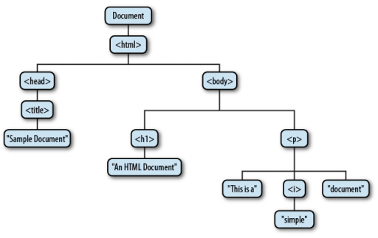
A sample DOM tree
a node
a parent
siblings
child nodes
a node

Slide 7
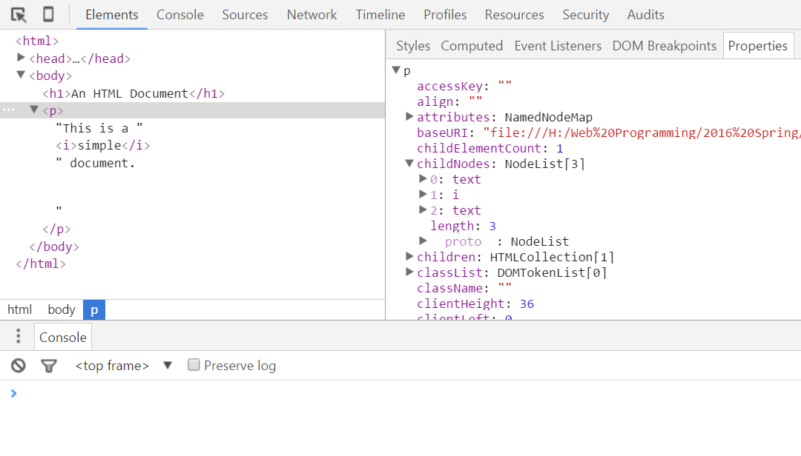
DOM Tree in Chrome browser
child nodes
developer tools that can display a visual representation of a document’s DOM tree.

Slide 8
Node Types
Three types of the Node
At the root of the tree is the Document node that represents the entire document
The nodes that represent HTML elements are Element nodes
The nodes that represent text are Text nodes
Document, Element, and Text are subclasses of Node
There is a formal distinction between the generic Document and Element types
The Document type represents either an HTML or an XML document, and the Element class represents an element of such a document.
The HTMLDocument and HTMLElement subclasses are specific to HTML documents and elements.

Slide 9
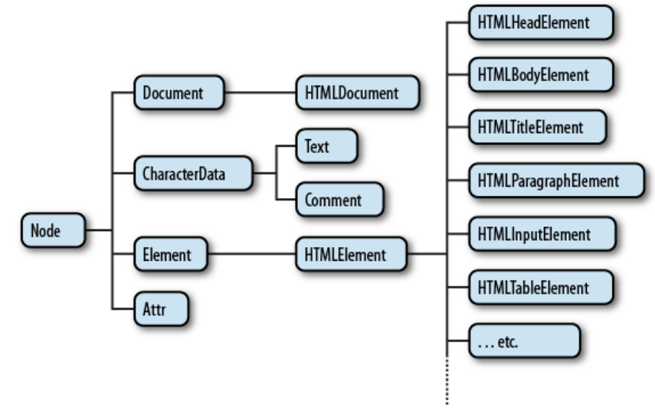
A partial class hierarchy of document nodes

Slide 10
Element Object
Property / Method | Description
element.accessKey | Sets or returns the accesskey attribute of an element
element.addEventListener() | Attaches an event handler to the specified element
element.appendChild() | Adds a new child node, to an element, as the last child node
element.attributes | Returns a NamedNodeMap of an element's attributes
element.blur() | Removes focus from an element
element.childElementCount | Returns the number of child elements an element has
element.childNodes | Returns a collection of an element's child nodes (including text and comment nodes)
element.children | Returns a collection of an element's child element (excluding text and comment nodes)
element.classList | Returns the class name(s) of an element
element.className | Sets or returns the value of the class attribute of an element
element.click() | Simulates a mouse-click on an element

Slide 11
SubTypes of HTMLElement
subtypes of HTMLElement that represent specific types of HTML elements.
Each defines JavaScript properties to mirror the HTML attributes of a specific element or group of elements
Some of these element-specific classes define additional properties or methods that go beyond simple mirroring of HTML syntax https://www.w3.org/2003/01/dom2-javadoc/org/w3c/dom/html2/HTMLInputElement.html

Slide 12
HTMLINputElement
Property | Description
autocomplete | Sets or returns the value of the autocomplete attribute of a text field
autofocus | Sets or returns whether a text field should automatically get focus when the page loads
defaultValue | Sets or returns the default value of a text field
disabled | Sets or returns whether the text field is disabled, or not
form | Returns a reference to the form that contains the text field
list | Returns a reference to the datalist that contains the text field
maxLength | Sets or returns the value of the maxlength attribute of a text field
name | Sets or returns the value of the name attribute of a text field
pattern | Sets or returns the value of the pattern attribute of a text field
placeholder | Sets or returns the value of the placeholder attribute of a text field
readOnly | Sets or returns whether a text field is read-only, or not
required | Sets or returns whether the text field must be filled out before submitting a form
size | Sets or returns the value of the size attribute of a text field
type | Returns which type of form element a text field is
value | Sets or returns the value of the value attribute of the text field

Slide 13
Traversing and Modifying a DOM Tree
DOM allows to access a document’s elements, allowing you to modify its contents dynamically using JavaScript
DOM-node properties and methods for traversing the DOM tree, modifying nodes and creating or deleting content dynamically
Traversing and Modifying
How to query or select individual elements from a document
How to traverse a document as a tree of nodes, and how to find the ancestors, siblings, and descendants of any document element
How to query and set the attributes of document elements
How to query, set, and modify the content of a document
How to modify the structure of a document by creating, inserting, and deleting nodes
How to work with HTML forms

Slide 14
Documents As Trees of Nodes
The Document object, its Element objects, and the Text objects that represent runs of text in the document are all Node objects.
Node defines the following important properties:
parentNode The Node that is the parent of this one, or null for nodes like the Document object that have no parent.
childNodes A read-only array-like object (a NodeList) that is a live representation of a Node’s child nodes.
firstChild, lastChild The first and last child nodes of a node, or null if the node has no children.
nextSibling, previousSibling The next and previous sibling node of a node. Two nodes with the same parent are siblings. Their order reflects the order in which they appear in the document. These properties connect nodes in a doubly linked list.

Slide 15
Documents As Trees of Nodes [2]
nodeType The kind of node this is. Document nodes have the value 9. Element nodes have the value 1. Text nodes have the value 3. Comments nodes are 8 and DocumentFragment nodes are 11.
nodeValue The textual content of a Text or Comment node.
nodeName The tag name of an Element, converted to uppercase.
Using these Node properties, the second child node of the first child of the Document can be referred to with expressions like these:
document.childNodes[0].childNodes[1]
document.firstChild.firstChild.nextSibling

Slide 16
Example
<html> <head> <title>Sample Document</title> </head> <body> <h1>An HTML Document</h1> <p>This is a <i>simple</i> document.</p>
</body> </html>
document.childNodes[1].childNodes[1] = ?
document.childNodes[1].childNodes[1].nodeType = ?
document.childNodes[1].childNodes[1].firstChild.nodeValue = ?

Slide 17
Documents As Trees of Elements
When we are primarily interested in the Elements of a document instead of the text within them (and the whitespace between them),
it is helpful to use an API that allows us to treat a document as a tree of Element objects, ignoring Text and Comment nodes that are also part of the document
The first part of this API is the children property of Element objects. Like childNodes, this is a NodeList. Unlike childNodes, however, the children list contains only Element objects.
Text and Comment nodes cannot have children, which means that the Node.parentNode property described above never returns a Text or Comment node.
The parentNode of any Element will always be another Element, or, at the root of the tree, a Document or DocumentFragment.

Slide 18
Documents As Trees of Elements
firstElementChild, lastElementChild
Like firstChild and lastChild, but for Element children only.
nextElementSibling, previousElementSibling
Like nextSibling and previousSibling, but for Element siblings only.
childElementCount
The number of element children. Returns the same value as children.length.

Slide 19
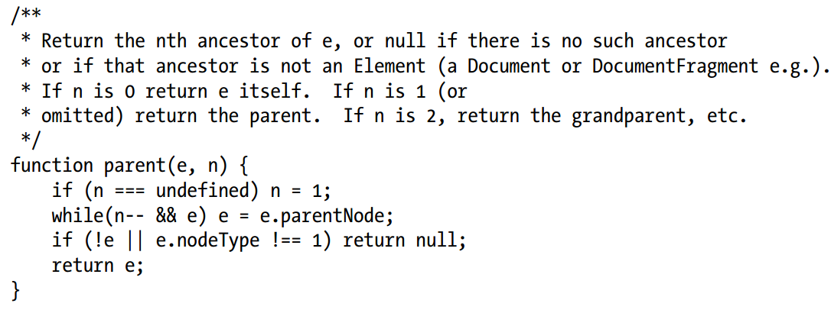
Portable document traversal functions

Slide 20
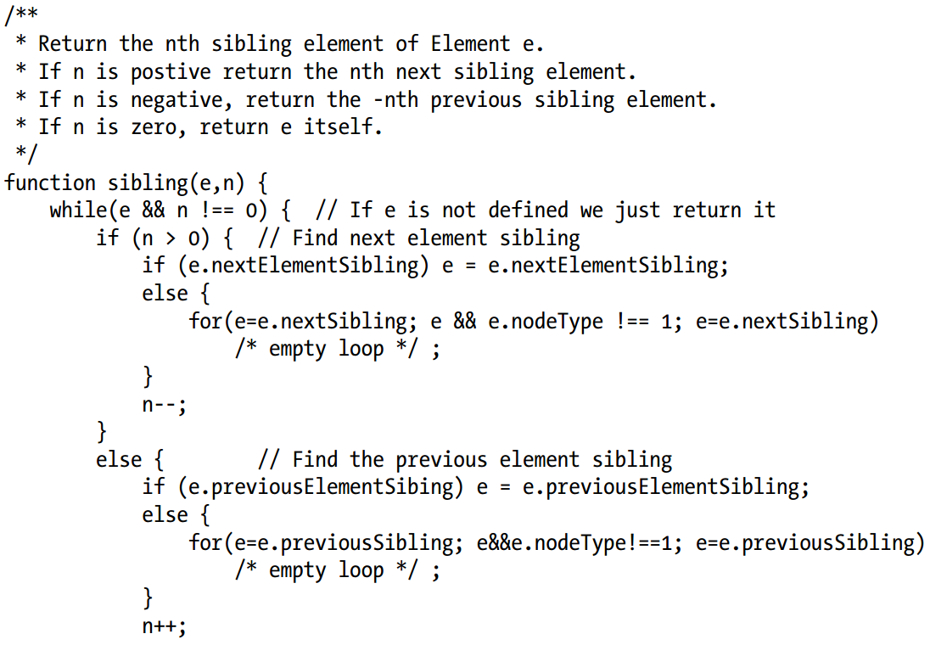
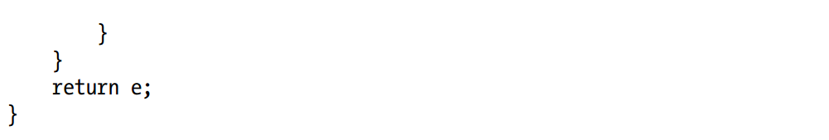
Portable document traversal functions [2]

Slide 21
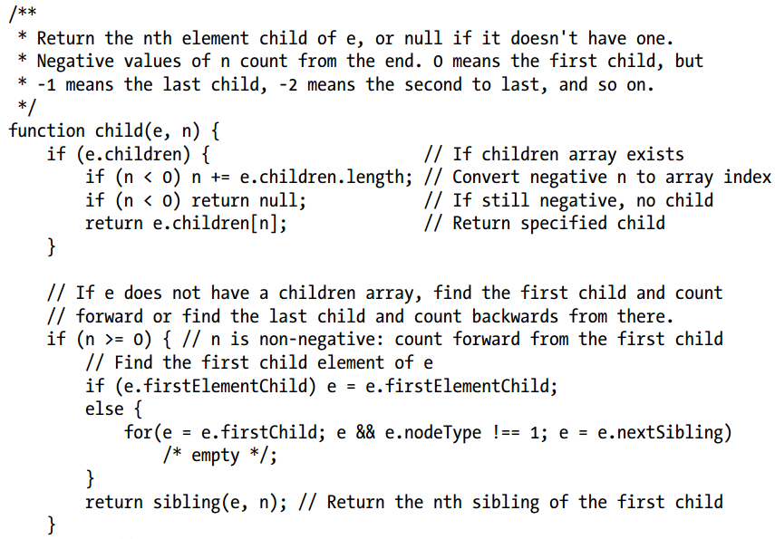
Portable document traversal functions [3]

Slide 22
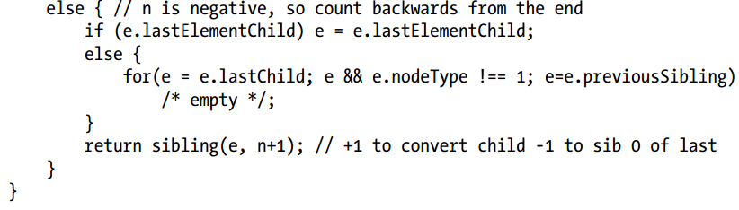
Portable document traversal functions [4]

Slide 23
Attributes
HTML elements consist of a tag name and a set of name/value pairs known as attributes.
The <a> element that defines a hyperlink,
for example, uses the value of its href attribute as the destination of the link.
The attribute values of HTML elements are available as properties of the HTMLElement objects that represent those elements.
The DOM also defines other APIs for getting and setting the values of XML attributes and nonstandard HTML attributes.

Slide 24
HTML Attributes As Element Properties
The HTMLElement objects that represent the elements of an HTML document define read/write properties that mirror the HTML attributes of the elements.
HTMLElement defines properties for the universal HTTP attributes such as id, title lang, and dir, and event handler properties like onclick.
Element-specific subtypes define attributes specific to those elements.
To query the URL of an image, for example, you can use the src property of the HTMLElement that represents the <img> element
var image = document.getElementById("myimage"); var imgurl = image.src; // The src attribute is the URL of the image image.id === "myimage" // Since we looked up the image by id

Slide 25
HTML Attributes As Element Properties [2]
set the form-submission attributes of a <form> element
var f = document.forms[0]; // First <form> in the document f.action = "http://www.example.com/submit.php"; // Set URL to submit it to. f.method = "POST"; // HTTP request type
HTML attributes are not case sensitive, but JavaScript property names are.
first letter of each word after the first in uppercase: defaultChecked and tabIndex
The properties that represent HTML attributes usually have string value.
When the attribute is a boolean or numeric value (the defaultChecked and maxLength attributes of an <input> element, for example), the properties values are booleans or numbers instead of strings.
Event handler attributes always have Function objects (or null) as their values.

Slide 26
Getting and Setting Non-HTML Attributes
The Element type also defines getAttribute() and setAttribute() methods
to query and set nonstandard HTML attributes and
to query and set attributes on the elements of an XML document
var image = document.images[0]; var width = parseInt(image.getAttribute("WIDTH")); image.setAttribute("class", "thumbnail");
attribute values are all treated as strings.
getAttribute() never returns a number, boolean, or object
hasAttribute()
check for the presence of a named attribute
removeAttribute()
remove an attribute entirely

Slide 27
Dataset Attributes
useful to attach additional or custom information to HTML elements
this can be done by adding special identifiers to the class attribute
for more complex data, client-side programmers resort to the use of nonstandard attributes
getAttribute() and setAttribute() methods to read and write the values of nonstandard attributes but
your document will not be valid HTML
HTML5 solution:
any attribute whose name is lowercase and begins with the prefix “data-” is considered valid.
These “dataset attributes” will not affect the presentation of the elements on which they appear and they define a standard way to attach additional data without compromising document validity
HTML5 also defines a dataset property on Element objects
This property refers to an object, which has properties that correspond to the data- attributes with their prefix removed

Slide 28
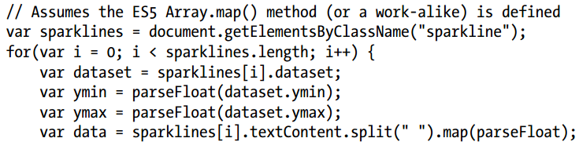
Dataset Attributes [2]
dataset.x would hold the value of the data-x attribute.
Hyphenated attributes map to camel-case property names:
the attribute data-jquery-test becomes the property dataset.jqueryTest <span class="sparkline" data-ymin="0" data-ymax="10"> 1 1 1 2 2 3 4 5 5 4 3 5 6 7 7 4 2 1 </span>

Slide 29
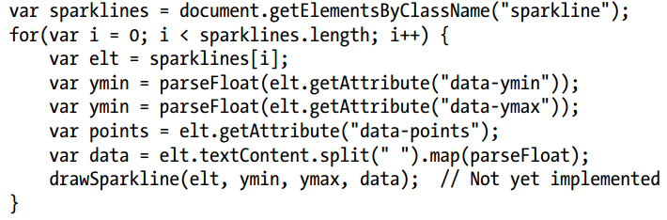
Dataset Attributes [3]

Slide 30
Attributes As Attr Nodes
There is one more way to work with the attributes of an Element. The Node type defines an attributes property.
This property is null for any nodes that are not Element objects.
For Element objects, attributes is a read-only array-like object that represents all the attributes of the element.
The attributes object is live in the way that NodeLists are.
It can be indexed numerically, which means that you can enumerate all the attributes of an element.
document.body.attributes[0] // The first attribute of the <body> elt
document.body.attributes.bgcolor // The bgcolor attribute of the <body> elt
document.body.attributes["ONLOAD"] // The onload attribute of the <body> elt

Slide 31
Element Content
<p>This is a <i>simple</i> document.</p>
What is content of <p>?
3 valid answers:
The content is the HTML string “This is a <i>simple</i> document.”
The content is the plain-text string “This is a simple document.”
The content is a Text node, an Element node that has a Text node child, and another Text node.

Slide 32
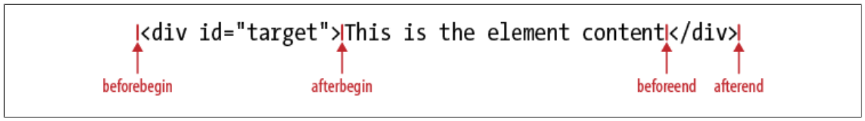
Element Content As HTML
innerHTML
geting: returns the content of that element as a string of markup
setting: invokes the web browser’s parser and replaces the element’s current content with a parsed representation of the new string
outerHTML
getting: returns the opening and closing tags of the element
setting: on an element, the new content replaces the element itself
insertAdjacentHTML(position, text)
method, which allows you to insert a string of arbitrary HTML markup “adjacent” to the specified element
the first argument – a position to insert
the second – the markup (text)

Slide 33
Element Content As Plain Text
to query the content of an element as plain text, or to insert plain text into a document
textContent property of Node
a straightforward concatenation of all Text node descendants of the specified element
innerText in IE
innerText does not return the content of <script> elements and is treated as a read-only property for certain table elements such as <table>, <tbody>, and <tr>
var para = document.getElementsByTagName("p")[0]; // First <p> in the document var text = para.textContent; // Text is "This is a simple document." para.textContent = "Hello World!"; // Alter paragraph content

Slide 34
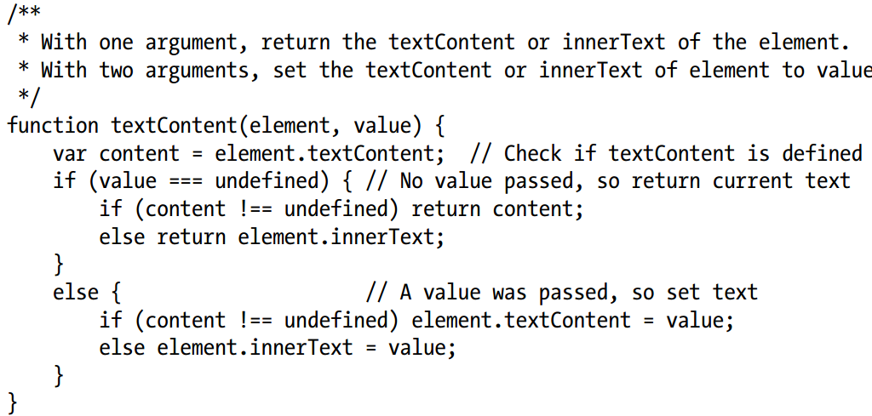
Element Content As Plain Text [2]
to distinguish empty elements (the string "" is falsy in JavaScript) from undefined properties

Slide 35
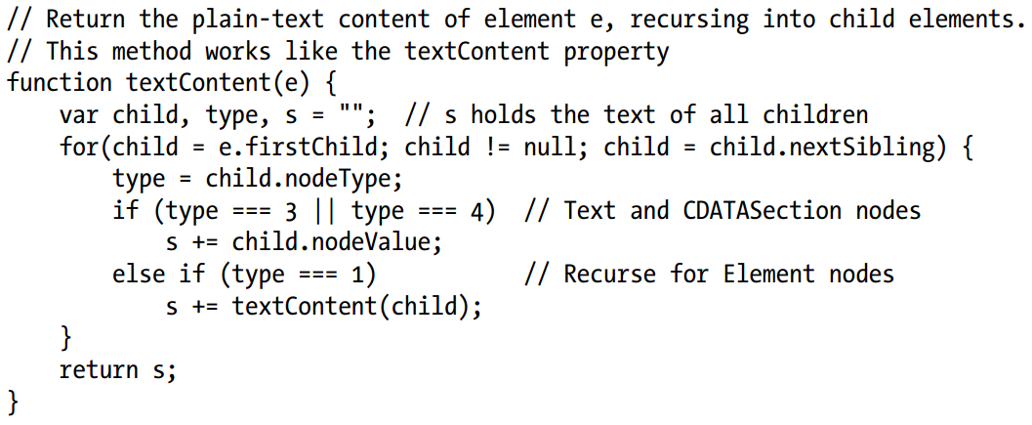
Element Content As Text Nodes
Another way to work with the content of an element is as a list of child nodes
We can write a textContent() function that recursively traverses the children of an element and concatenates the text of all the Text node descendants

Slide 36
Creating, Inserting, and Deleting Nodes
The Document type defines methods for creating Element and Text objects, and the Node type defines methods for inserting, deleting, and replacing nodes in the tree
// Asynchronously load and execute a script // from a specified URL function loadasync(url) { var head = document.getElementsByTagName("head")[0]; // Find document <head> var s = document.createElement("script"); // Create a <script> element s.src = url; // Set its src attribute head.appendChild(s); // Insert the <script> into head }
createElement(tagName) :
tag name of the element is case-insensitive for HTML documents

Slide 37
Creating Nodes
Text nodes are created with document.createTextNode()
var newnode = document.createTextNode("text node content");
Another way to create new document nodes is to make copies of existing ones.
Every node has a cloneNode() method that returns a new copy of the node.
Pass true to recursively copy all descendants as well, or false to only make a shallow copy
In IE, importNode()
If you pass it a node from another document, it returns a copy suitable or insertion into this document. Pass true as the second argument to recursively import all descendants.

Slide 38
Inserting Nodes
Once you have a new node, you can insert it into the document with the Node methods appendChild() or insertBefore().
appendChild()
is invoked on the Element node that you want to insert into, and it inserts the specified node so that it becomes the lastChild of that node
if you call appendChild() or insertBefore() to insert a node that is already in the document,
that node will automatically be removed from its current position and reinserted at its new position: there is no need to explicitly remove the node.
// Insert the child node into parent so that it becomes child node n function insertAt(parent, child, n) { if (n < 0 || n > parent.childNodes.length) throw new Error("invalid index"); else if (n == parent.childNodes.length) parent.appendChild(child); else parent.insertBefore(child, parent.childNodes[n]); }

Slide 39
Removing and Replacing Nodes
removeChild() method removes a node from the document tree
it should be invoked on the parent of that node
and pass the child node that is to be removed as the method argument
n.parentNode.removeChild(n);
replaceChild() removes one child node and replaces it with a new one
Invoke this method on the parent node, passing the new node as the first argument and the node to be replaced as the second argument
n.parentNode.replaceChild(document.createTextNode("[ REDACTED ]"), n);
function embolden(n) { // If we're passed a string instead of a node, treat it as an element id if (typeof n == "string") n = document.getElementById(n); var parent = n.parentNode; // Get the parent of n var b = document.createElement("b"); // Create a <b> element parent.replaceChild(b, n); // Replace n with the <b> element b.appendChild(n); // Make n a child of the <b> element }

